Slide 1
Exploratory Data Analysis
Python libraries
Pandas
Seaborn
matplotlib

Slide 2
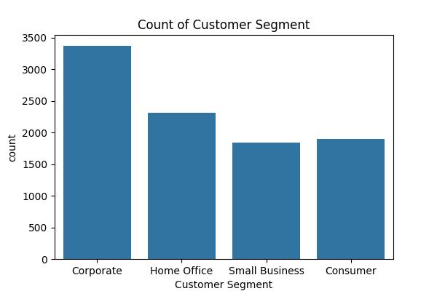

Slide 3
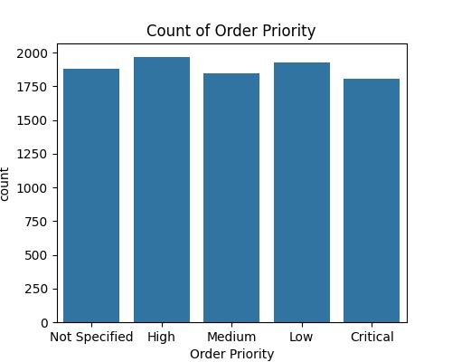

Slide 4
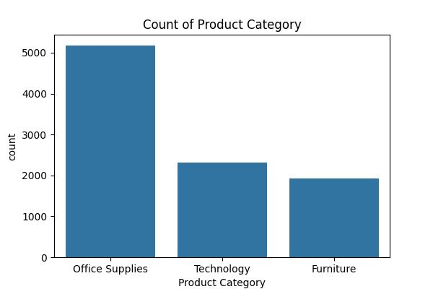

Slide 5
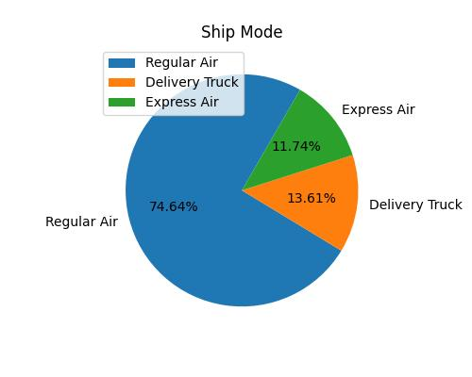

Slide 7
